Slide 1
ICPR Writing & Skimming Siggraph Asia
Presenter: Kim Seung Hwan (overnap@khu.ac.kr)

Slide 2
Review #07D5
Strengths of the paper
The paper presents a modification for variational autoencoders, in particular to the beta-VAE modality. The authors investigate theoretically and experimentally the role of the decoder variance, and propose a straightforward approach to resolve the ambiguity between both concepts, consisting in reintroducing ß into VAE with learnable variance decoder, named Beta-Sigma VAE (BS-VAE).
The paper is well written but accessible only to readers with a good knowledge of variational autoencoders. While it may be relevant to ICIP as the results are evaluated on two computer vision benchmarks, I think it may be more relevant to a machine learning conference, as the emphasis is more on learning than on image.
The authors compare their method against the beta-vae and show superior performance.
Weaknesses of the paper
The paper is only accessible to readers with a good knowledge of variational autoencoders. Making it accessible to a wider audience would require an extension that is not available in ICIP papers. Also, as I commented in Q1, this paper may be more relevant in other conferences more oriented to machine learning.
As I'm not en expert in VAEs, it is difficult for me to evaluate if the experimental validation is sufficient or whether there are other similar methods which should be reviewed.
Novelty/Originality/Contribution: Moderately original
Experimental Validation: Limited but convincing
Clarity of Presentation: Clear enough
Reference to Prior Work: References adequate

Slide 3
Review #1FDD
Strengths of the paper
This paper focuses on the separation of beta in the beta-VAE, in the hope of improving the quality of generated images. It's highly relevant to image processing.
Weaknesses of the paper
I have concerns over the effectiveness of working separating beta and variance of decoder.
1. This paper works on beta VAE which does not achieve the best image generation quality in today's standard. The performance baseline is obsolete. And based on Fig 2. the quality is very poor.
Is there any practical use case of separating beta?
The FID in Table 1. is not convincing enough given it is still huge. An improvement against a baseline that is far behind the current SOTA is meaningless.
Similar issues using CelebA and MNIST, these datasets are not adequate in today's standard of evaluating image generation quality.
2. It seems the technical contribution of the work is also limited, with the variance of decoder becoming learnable.
It's a marginal contribution to existing beta-VAE, which has been published in ICLR in 2017.
Novelty/Originality/Contribution: Minor originality
Experimental Validation: Lacking in some respect
Clarity of Presentation: Clear enough
Reference to Prior Work: References adequate

Slide 4
(Previous) Goal
I plan to revise the paper during the vacation
And submit it to another conference
Maybe ICPR; but it’s due next week
No changes have been made yet 🤪
I can revise the writing
But will I able to experiment with heavy SOTA models?

Slide 5
Target Improvements
Clear writing:
Highlighting contributions
Considering readers who aren’t aware of the topic
Avoiding ambiguous wording
Experiments:
Experimenting with deep models and large datasets
Applying very heavy SOTA models

Slide 6
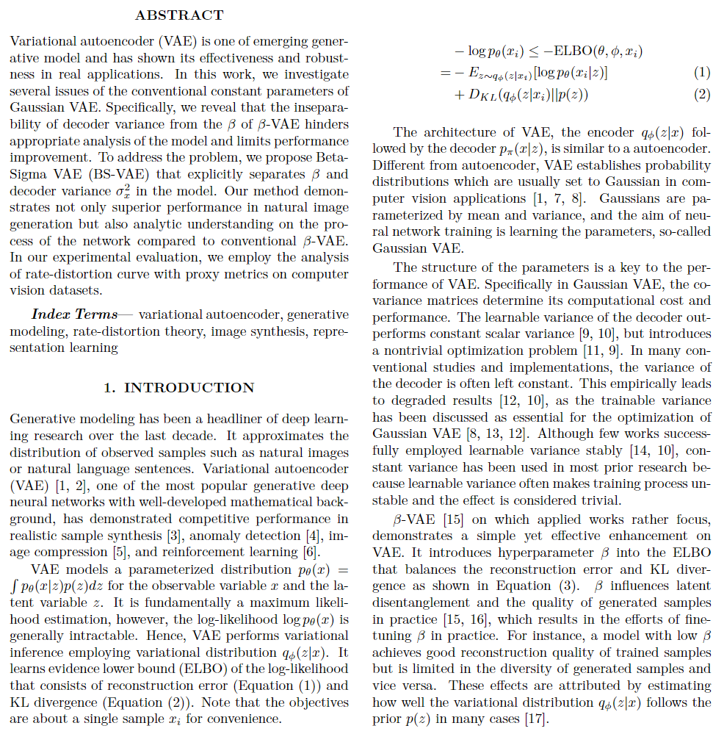
A Concise Introduction
ICIP version
Trying to capture all motivations
Including background knowledge
May be lengthy and difficult

Slide 7
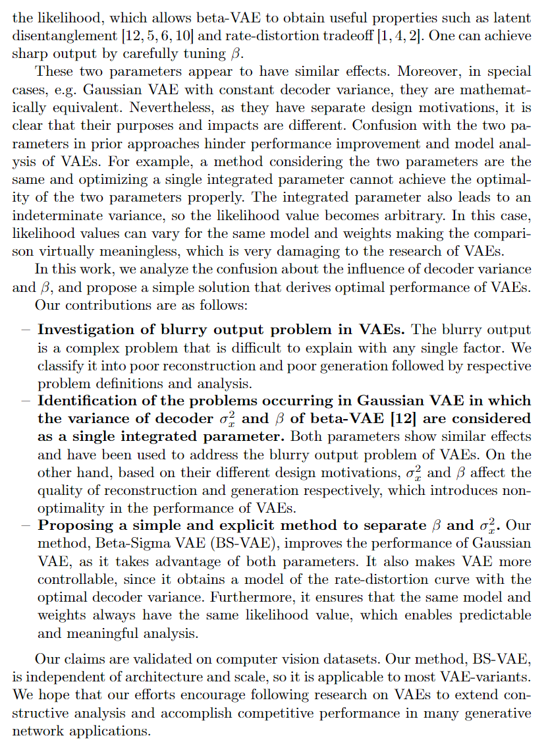
A Concise Introduction
ICPR version
It’s shorter
Contains only motivation & contribution
Very very very,
Strong emphasis on contribution

Slide 8
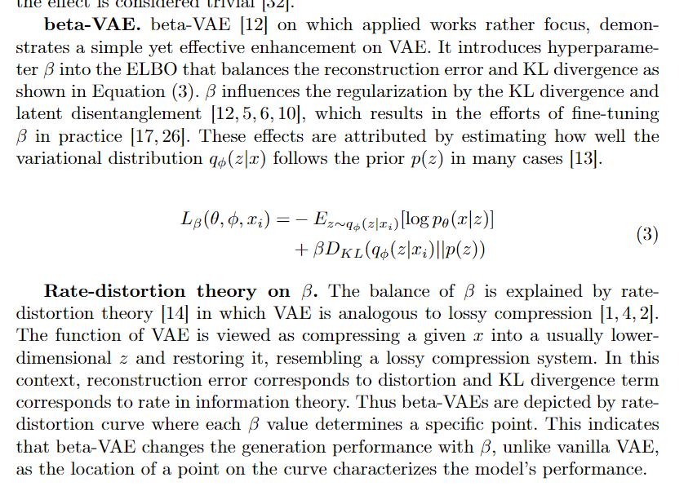
Separation of Background
Information loss inevitably occurs
Create a background section to separate it
Explicitly state that this section is about previous research
Good for both topic-familiar and not

Slide 9
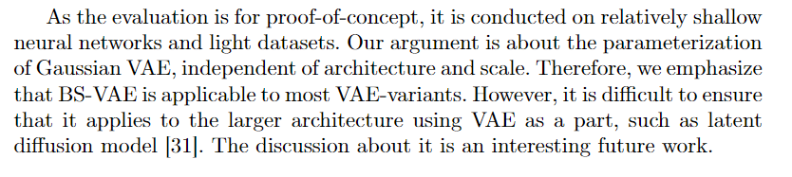
Disclaimer About Mild Experiment
Emphasize that the experiment is intended as a proof-of-concept
Adding “because our method is independent of architecture and scale of neural network, it will be good even for large models~ blahblah”

Slide 10
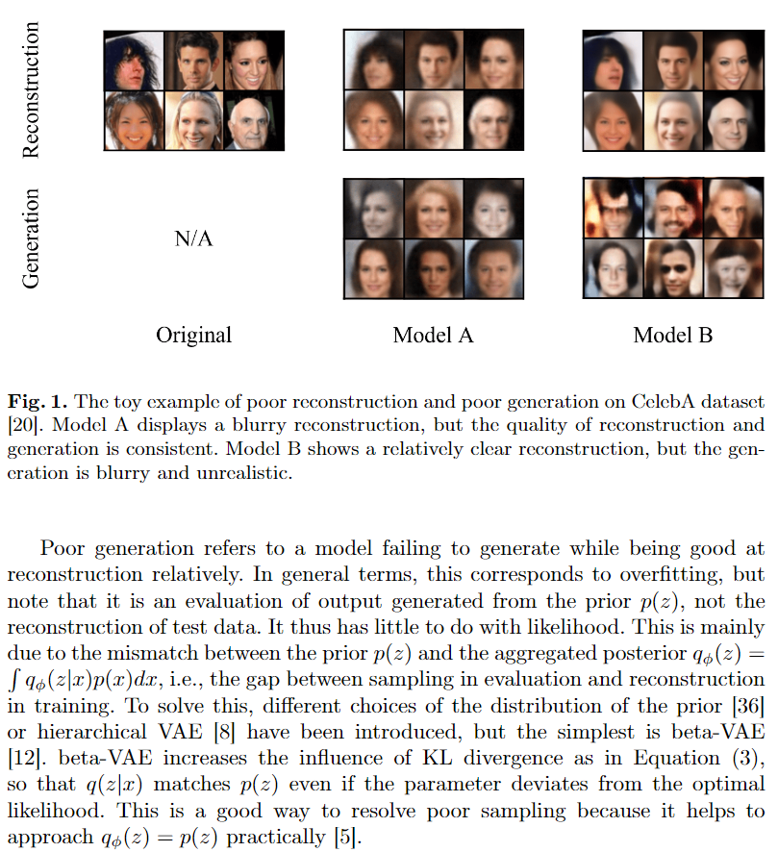
Strive to Raise Issue
Add section highlighting motivation
Helpful even to unfamiliar readers

Slide 11
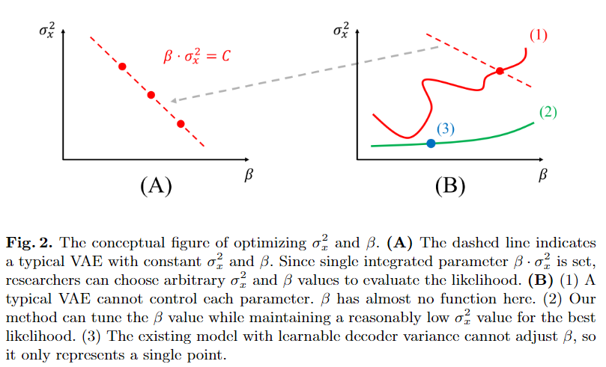
Conceptual Figure

Slide 12
More Direct and Specific Expression
“The existing view on two parameters was ambiguous, so we solved it. This way, the performance even improved!”
→ “The existing view derives random likelihood, which harms the research community. Getting the optimum is difficult, because it cannot obtain the full benefit from both parameters.”

Slide 13
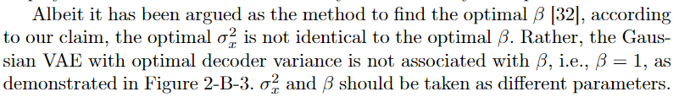
More Direct and Specific Expression
“This part of previous works is different from our perspective.”
→ “This part of previous works is wrong because of this and that blahblah.”

Slide 14
Next Goal?
The remaining conferences this year are very tight in deadline
I'm thinking about doing a poster
SIGGRAPH Asia (Aug 11, Poster)

Slide 15
Next Topic
Copyright and privacy preserving generative models
Generative models for very specific cases in graphics
(Unsurprisingly) very shallow VAEs are good at reconstruction

Slide 16
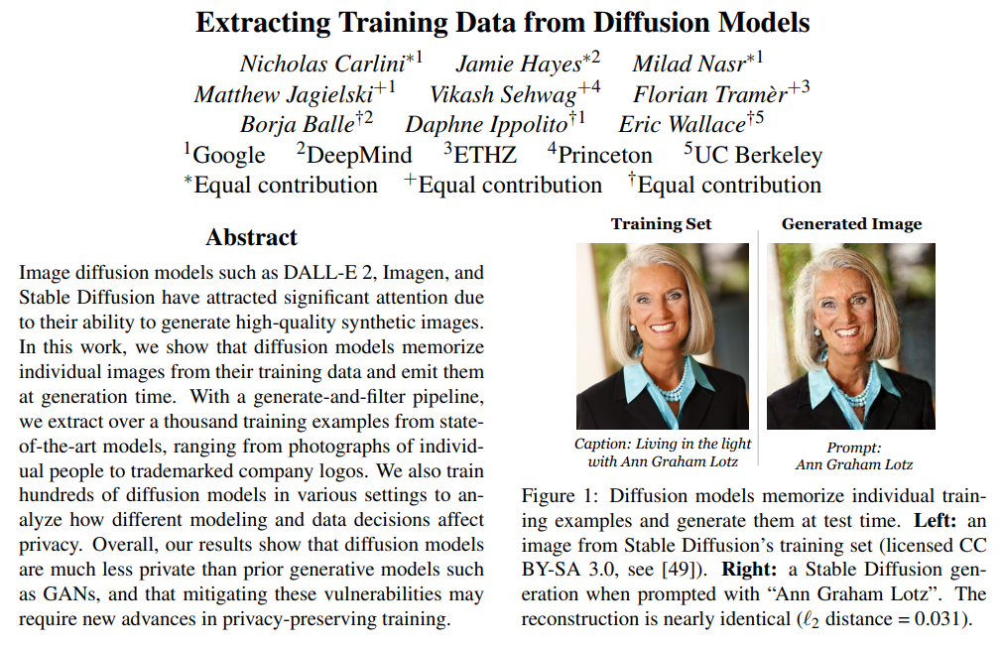
Copyright and Privacy?

Slide 17
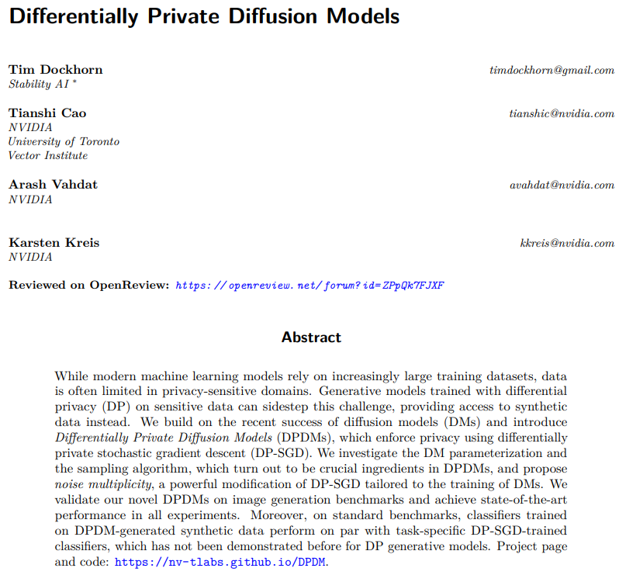
Copyright and Privacy?

Slide 18
Very Specific Case in Graphics?
Let’s skim Siggraph Asia 2023
There are a lot of papers
So if you have any questions, please ask them right away

Slide 19
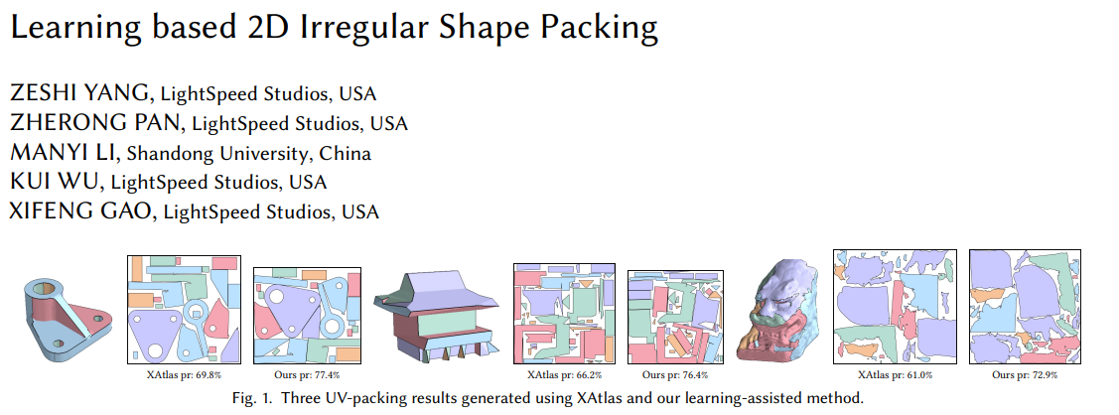
Very Specific Case in Graphics?

Slide 20
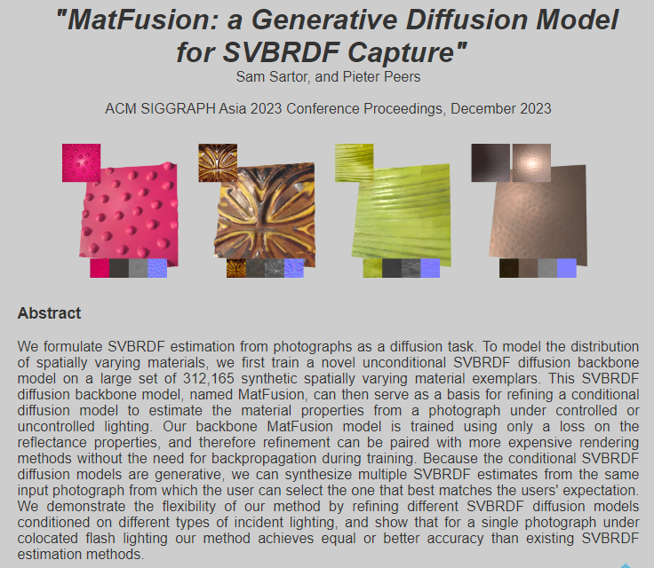
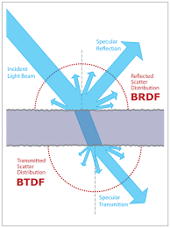
Very Specific Case in Graphics?

Slide 21
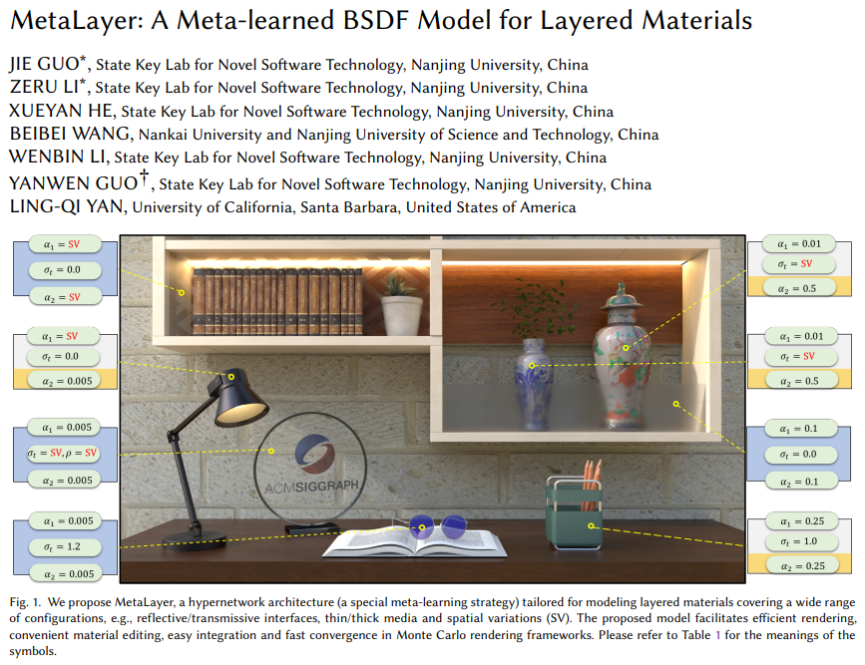
Very Specific Case in Graphics?

Slide 22
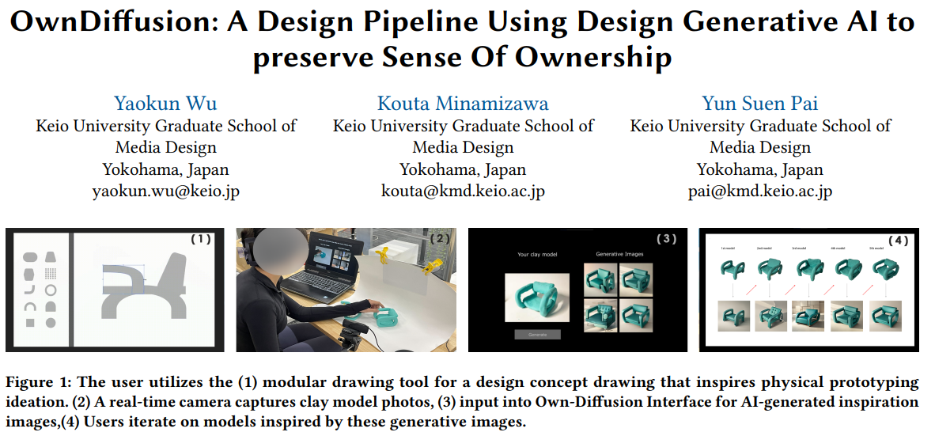
Very Specific Case in Graphics?

Slide 23
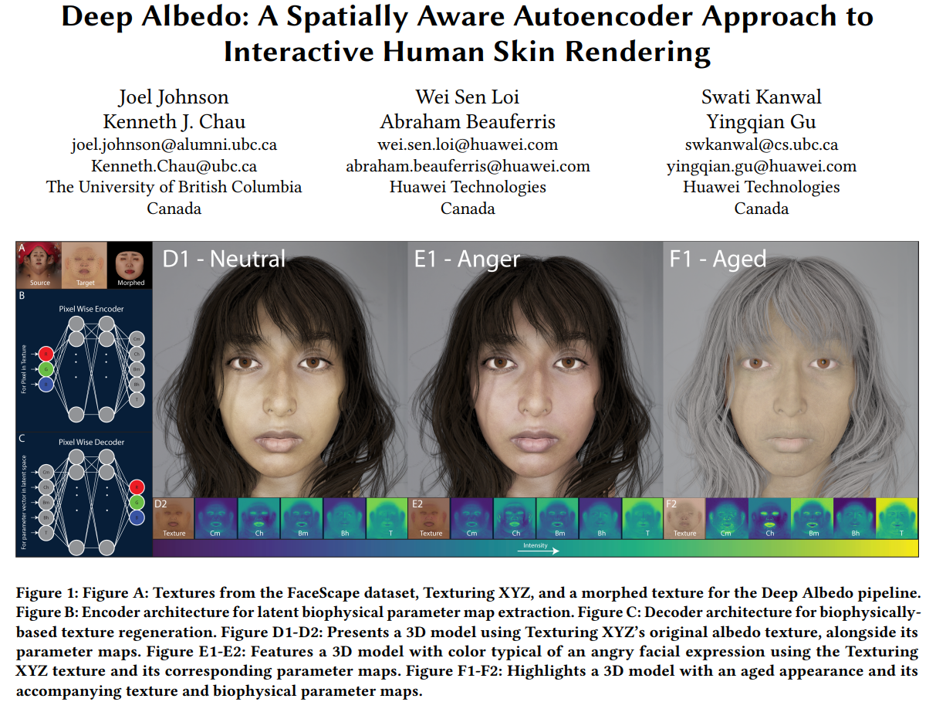
Very Specific Case in Graphics?

Slide 24
Idea: LDM can be a key
Still (special properties, easy to handle) latent variables need autoencoder-variants
Latent variables of high-performing diffusion models are not very meaningful
What about LDM? Latent variables and diffusion are separate
What if we add appropriate latent space loss
to both the autoencoder and diffusion of LDM?
So what is the target task?

Slide 25
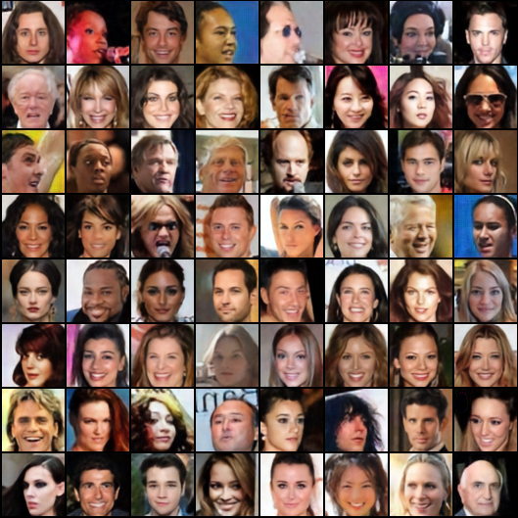

Shallow VAE?

Slide 26
Thank you for listening
Presenter: Kim Seung Hwan (overnap@khu.ac.kr)

